Slide 1
Microsoft Project 2007
Tracking and Reporting Project Status

Slide 2
Course Objectives
Updating Project Status
  Update Baseline
  Update Actual Work
  Interruption in the work
Tracking and Reporting Project Status
  Tracking schedule variance.
  Tracking cost variance.
  Customizing view for reporting
CPMEI – All Rights Reserved

Slide 3
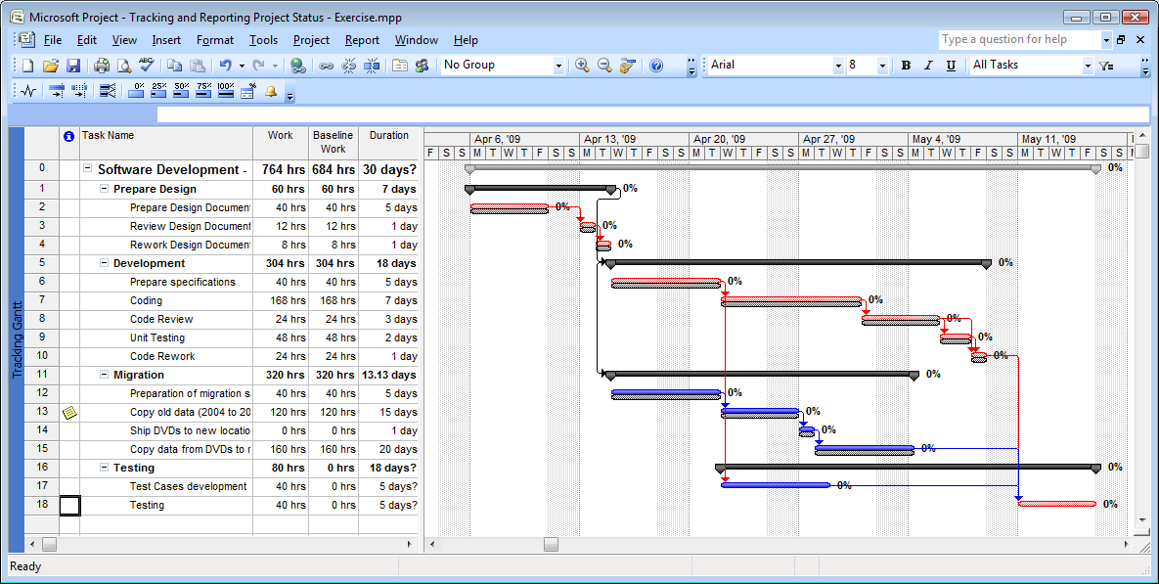
View Baseline
Schedule
baseline
CPMEI – All Rights Reserved

Slide 4
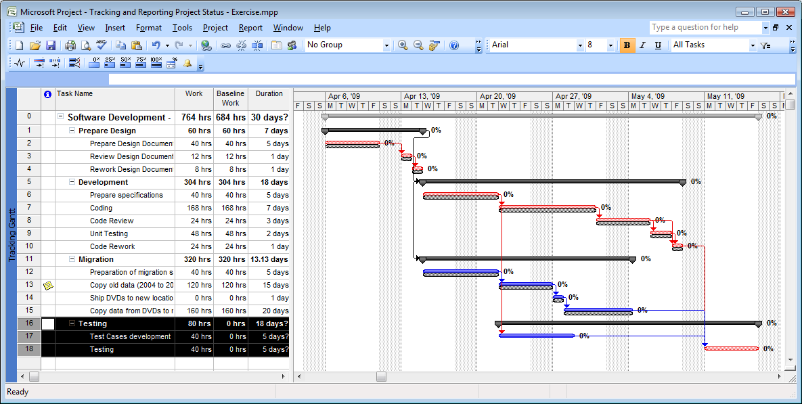
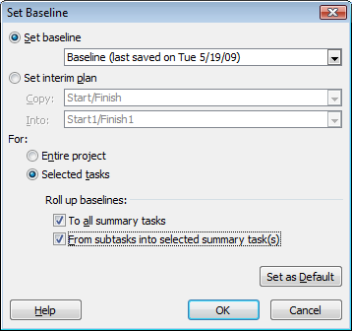
Set/update Baseline
Any previous baseline data will be overwritten
CPMEI – All Rights Reserved

Slide 5
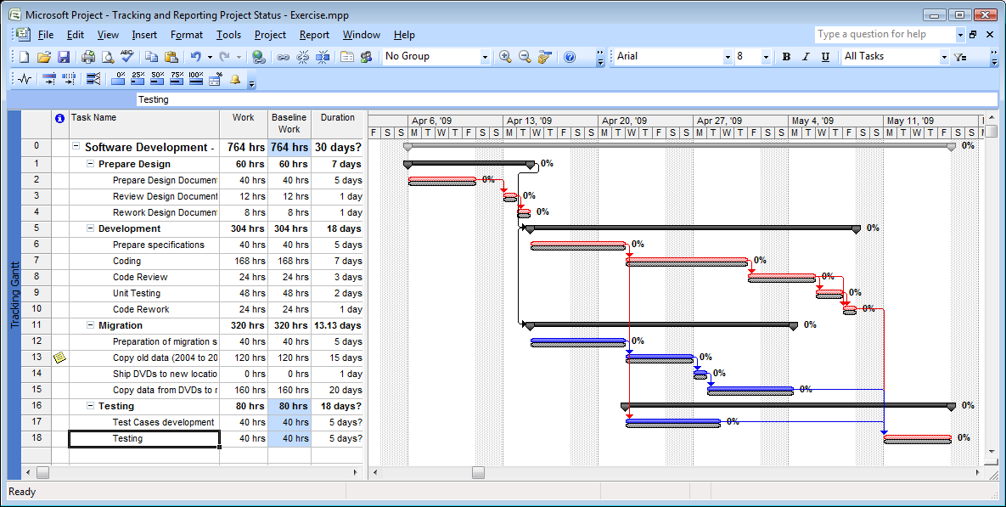
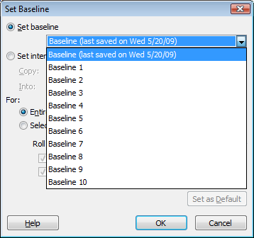
Multiple Baselines
CPMEI – All Rights Reserved

Slide 6
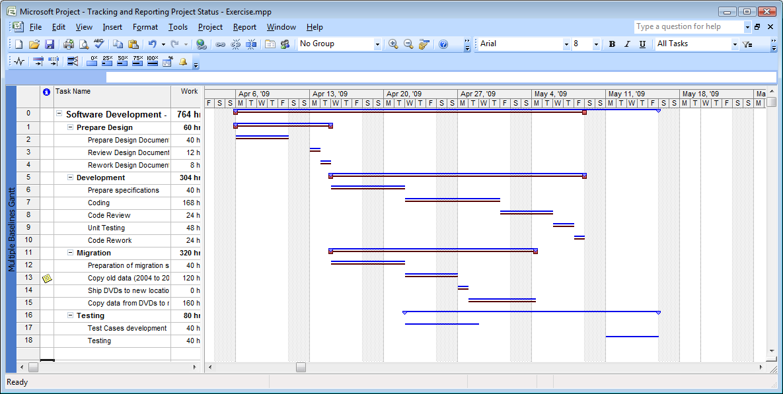
Multiple Baselines
You can compare 1st three baselines
CPMEI – All Rights Reserved

Slide 7
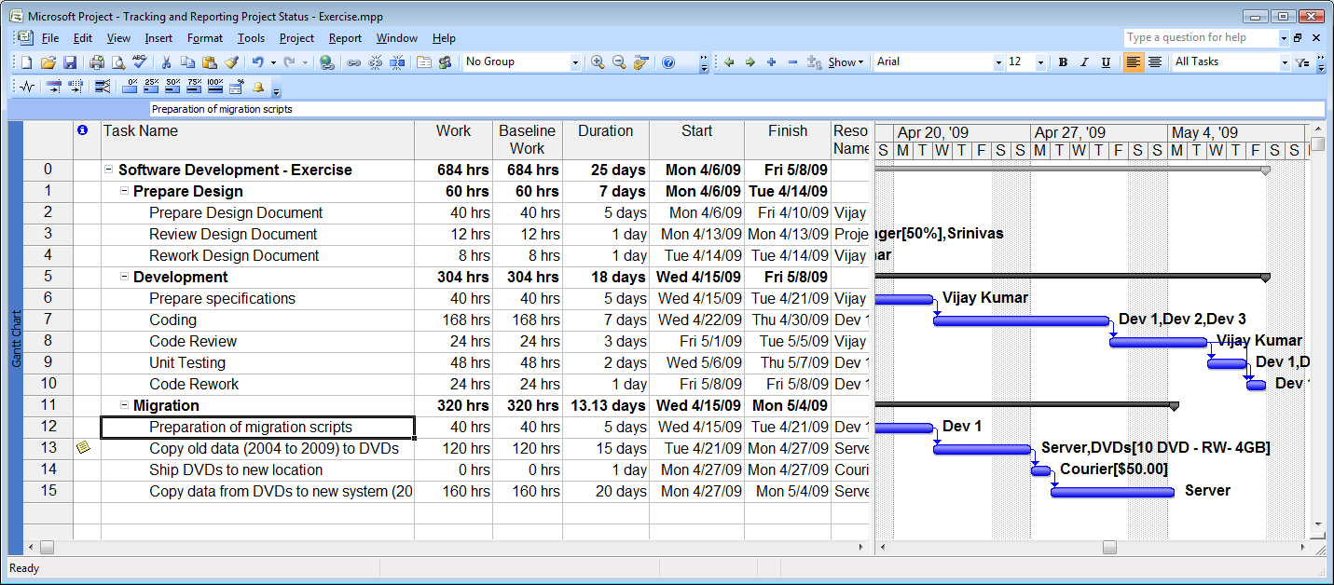
Update actual work done
View: Gantt Chart
CPMEI – All Rights Reserved

Slide 8
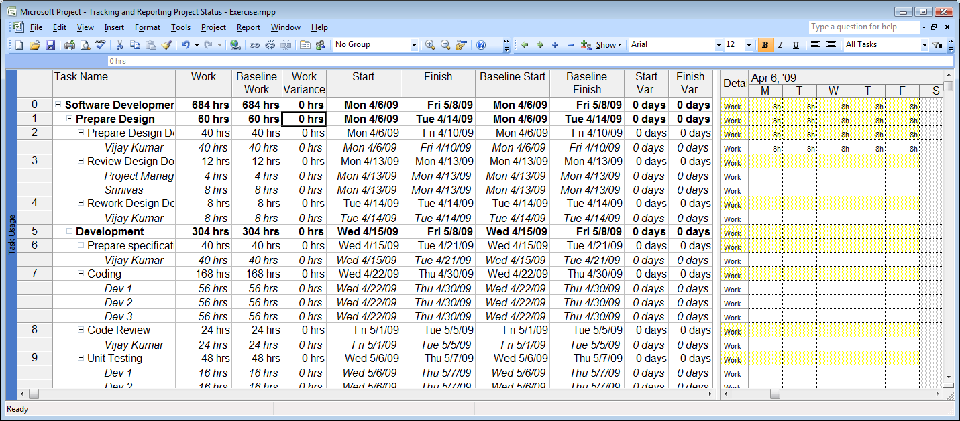
Update actual work done
View: Task Usage; Table: Variance
CPMEI – All Rights Reserved

Slide 9
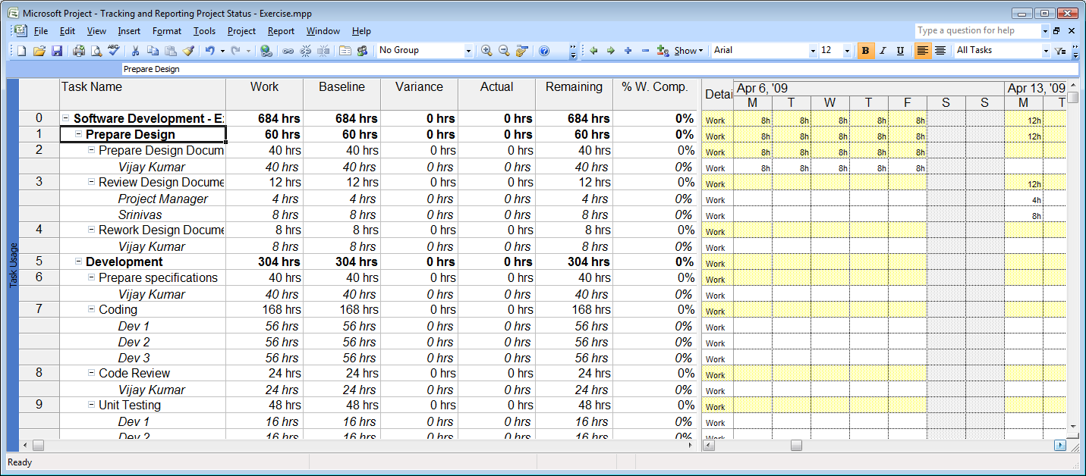
Update actual work done
View: Task Usage; Table: Work
CPMEI – All Rights Reserved

Slide 10
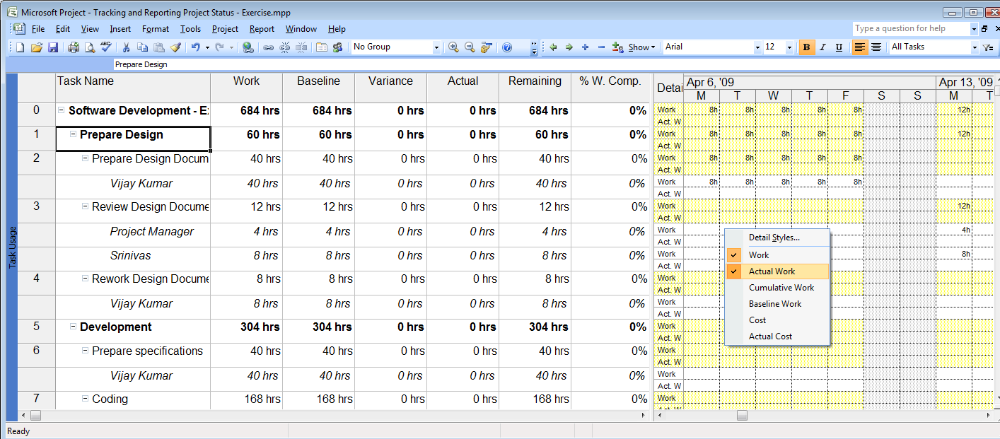
Update actual work done
View: Task Usage; Table: Work
CPMEI – All Rights Reserved

Slide 11
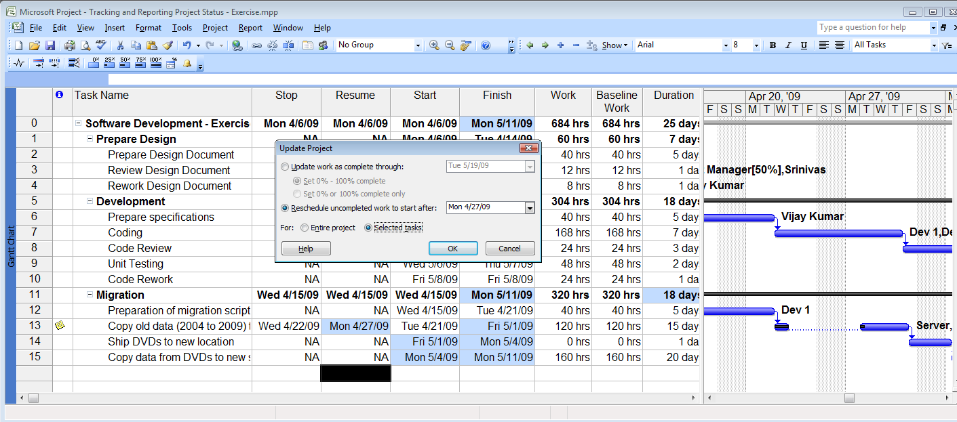
Interruption in the work
Server is not available. Next available date is 27th April
CPMEI – All Rights Reserved

Slide 12
Question
A task that takes 40 hours to complete is divided equally between two resources that are assigned to the task. The work assigned to the first resource is completed; however, the second resource is yet to start work. Which of the following methods should you use to update the actual work for this task?
Select the one best answer.
Set the Actual column for the first resource to 20h.
That is correct. To update actual work done by the resource, specify the actual work hours at the resource level.
Set the Actual column for the task to 20h.
That is not correct. If you specify the actual work at the task level, the remaining work on the task will be equally divided between the two resources. The correct response is: Set the Actual column for the first resource to 20h.
Set the % Work Complete column for the task to 50%.
That is not correct. If you specify the percentage of work completed at the task level, the remaining work on the task will be equally divided between the two resources. The correct response is: Set the Actual column for the first resource to 20h.
Set the Remaining column for the second resource to 20h
CPMEI – All Rights Reserved

Slide 13

Question
CPMEI – All Rights Reserved

Slide 14
Course Objectives
Updating Project Status
  Update Baseline
  Update Actual Work
  Interruption in the work
Tracking and Reporting Project Status
  Tracking schedule variance.
  Tracking cost variance.
  Customizing view for reporting
CPMEI – All Rights Reserved

Slide 15
Tracking Variance
Schedule Variance
  View & Tables
    View: Detail Gantt Chart
      Table: Variance – Work and Schedule variance, delay in starting the task
      Table: Schedule - Schedule & available slack
      Table: Tracking - Actual & Remaining Duration, Actual cost, work, start & finish
      Table: Work – Schedule, baselined, actual, remaining work & % Completion
    View: Tracking Gantt Chart
      Pictorial representation of schedule & actual start and end date and duration against baseline
      Impact of variance on schedule
  Filter
    Slipping Tasks – Filters the incomplete tasks that have delay in starting or ending
    Slipped/Late Progress Filter – Filters the tasks that will miss the end date due to late start or due to slow progress
CPMEI – All Rights Reserved

Slide 16
Tracking Variance
Cost Variance
  View & Tables
    View: Detail Gantt Chart
      Table: Cost – Actual Cost, Baseline Cost, Variance against baseline, Total Cost at Task Level
    View: Resource Sheet View
      Table: Cost – Resource Actual Cost, Baseline Cost, Variance against baseline, Total Cost & Remaining to go
  Filter
    Cost Over Budget – Filters the task that are over budgeted
    Cost Greater Than – Show tasks that have total cost greater then the given cost
    Project → Outlines → Show → <outline level> - You can see cost at different level or of different phase of project
CPMEI – All Rights Reserved

Slide 17
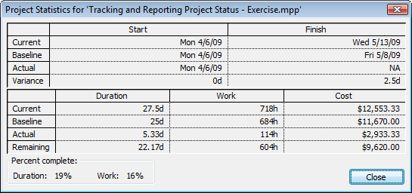
Tracking Variance
Project → Project Information → Statistics
CPMEI – All Rights Reserved

Slide 18
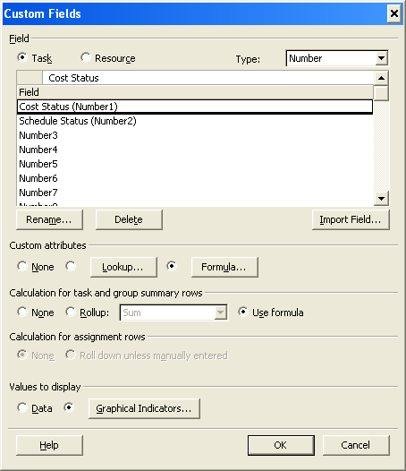
Customizing view for reporting
Select field to be customized Task or Resource
Select type of the field
The list of custom fields of the type you selected
Choose from list of values or formula
Choose how data in summary task will be updated
Choose how value will be displayed – data or graphical indicator
CPMEI – All Rights Reserved

Slide 19
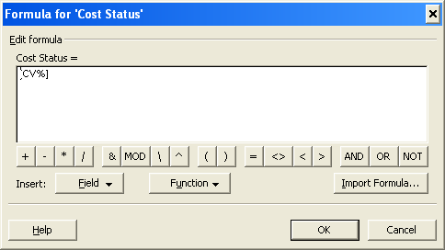
Customizing view for reporting
CPMEI – All Rights Reserved

Slide 20
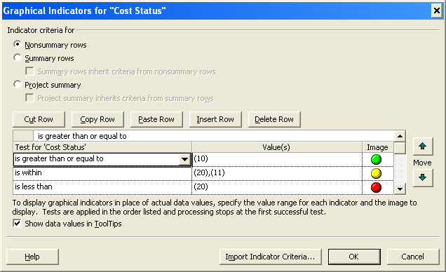
Customizing view for reporting
CPMEI – All Rights Reserved

Slide 21
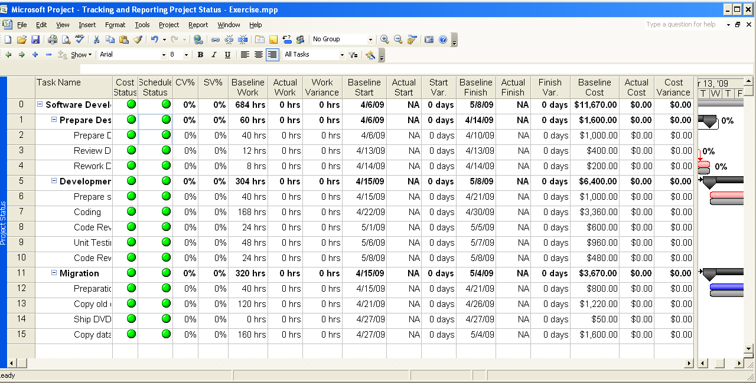
Customizing view for reporting
CPMEI – All Rights Reserved

Slide 22
Question
CPMEI – All Rights Reserved

Slide 23
Course Objectives
Updating Project Status
  Update Baseline
  Update Actual Work
  Interruption in the work
Tracking and Reporting Project Status
  Tracking schedule variance.
  Tracking cost variance.
  Customizing view for reporting
CPMEI – All Rights Reserved

